Slide 1
Solving Multi-Step Equations
I can solve equations of the form px + q = r and p(x+q) = r fluently. This means I can solve multi-step equations using the distributive property.

Slide 2
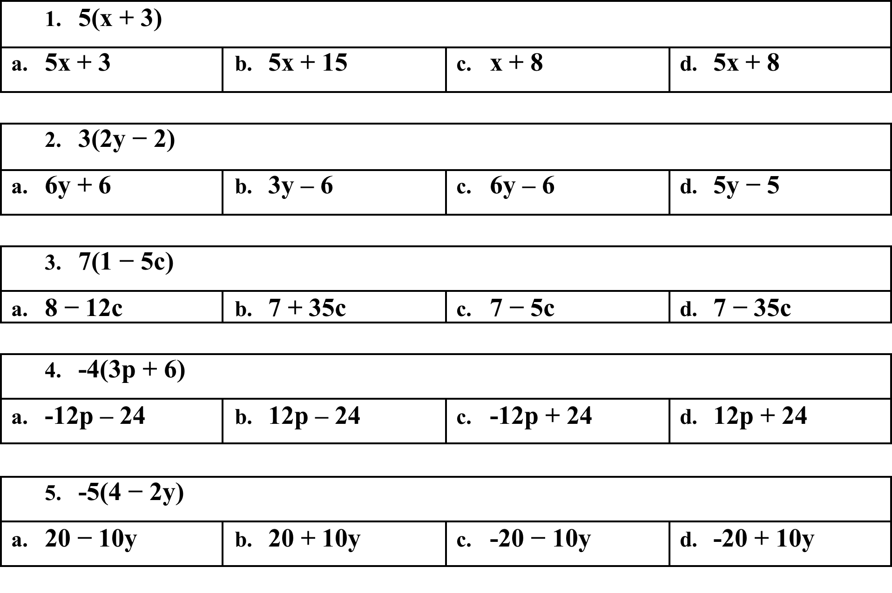
Flashback
Notes:
1. B 2. C 3. D 4. A 5. D

Slide 3
To solve MUTLI-STEP EQUATIONS, you just add one more step to solving two-step equations. It will be the first step.
Step One – Simplify the expression by distributing and/ or combining like terms.
Example 1:
3x + 6(4x + 2) = 66

Slide 4
First - Distribute
3x + 6(4x + 2) = 66
=3x + 24x + 12 = 66
Next – Combine Like Terms
3x + 24x + 12 = 66
=27x + 12 = 66

Slide 5
Now, use Sadmep to solve
27x + 12 = 66
-12 -12
27x = 54
27
x = 2

Slide 6
Check your answer with substitution :
3(2) + 6(4(2) + 2) = 66

Slide 7
First - Distribute
Example One
4(x + 2) = 2x - 2
=4x + 8 = 2x - 2
Next – Combine Like Terms
Nothing can be combined.
Remember, you can only combine separately on each side of the equation.

Slide 8
Now, use Sadmep to solve
4x + 8 = 2x – 2
-2x -2x
2x + 8 = -2
-8 -8
2x = -10
2 2
x = -5

Slide 9
Check your answer with substitution :
4(-5 + 2) = 2(-5) – 2
4(-3) = -10 – 2
-12 = -12

Slide 10
First - Distribute
Example Two
6x + 2 = -2(x + 3)
=6x + 2 = -2x -6
Next – Combine Like Terms
Nothing can be combined.

Slide 11
Now, use Sadmep to solve
6x + 2 = -2x – 6
+2x +2x
8x + 2 = -6
-2 -2
8x = -8
8
x = -1

Slide 12
Check your answer with substitution :
6(-1) + 2 = -2(-1 + 3)
-6 + 2 = 2 + -6
-4 = -4

Slide 13
First - Distribute
Example Three
8(2x + 5) + x = 74
=16x + 40 + x = 74
Next – Combine Like Terms
=17x + 5 = 74

Slide 14
Now, use Sadmep to solve
17x + 40 = 74
-40 = -40
17x = 34
17 17
x = 2

Slide 15
Check your answer with substitution :
8(2(2) + 5) + 2 = 74
8(9) + 2 = 74
74 = 74

Slide 16
First - Distribute
Example Four
5(y – 5) = 15
=5y – 25 = 15
Next – Combine Like Terms
Nothing can be combined.

Slide 17
Now, use Sadmep to solve
5y – 25 = 15
+25 +25
5y = 40
5 5
x = 8

Slide 18
Check your answer with substitution :
5 (8 – 5) = 15

Slide 19
First - Distribute
Example Five
6(x + 4) = 5(x – 2)
=6x + 24= 5x - 10
Next – Combine Like Terms
Nothing can be combined.
Note(You can only combine terms on each side of the equation separately.

Slide 20
Now, use Sadmep to solve
6x + 24 = 5x - 10
-5x = -5x
x + 24 = -10
-24 -24
x = -34

Slide 21
Check your answer with substitution :
6(-34+4) = 5(-34 – 2)

Slide 22
First - Distribute
Example Six
-2(x – 5) + x = 12 + 2
=-2x + 10 + x = 12 + 2
Next – Combine Like Terms
= -x + 10 = 14

Slide 23
Now, use Sadmep to solve
-x + 10 = 14
-10 = -10
- x = 4
-1 -1
x = -4

Slide 24
Check your answer with substitution :
-2(-4 – 5)+(- 4)= 12 + 2

Slide 25
Notes:
1. B 2. A 3. d 4. c 5. A

